Slide 1
JAVA Lecture 4
Overloading and “static” keyword

Slide 2





Slide 3
Overloading

Slide 4
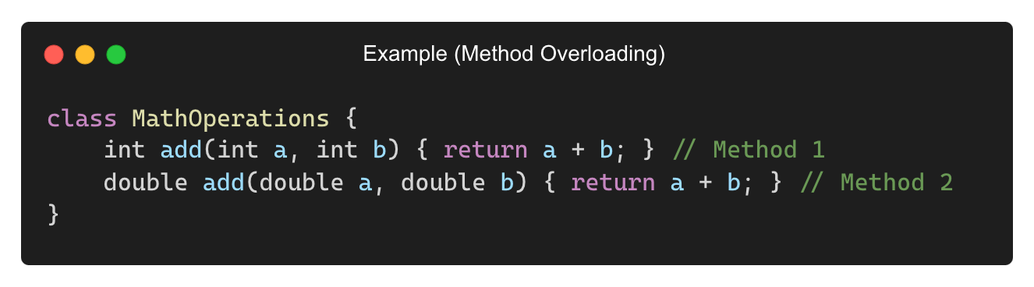
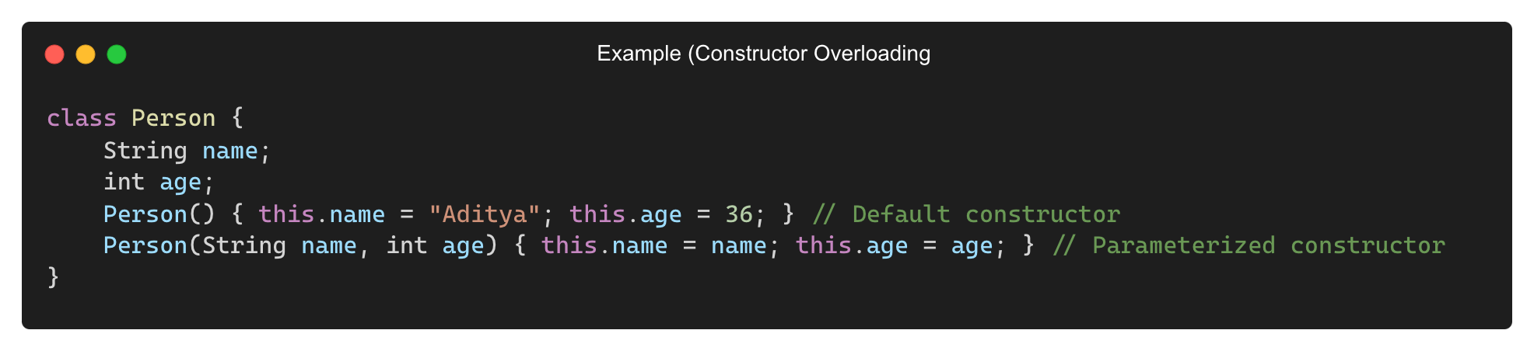
What is Overloading?
Overloading allows multiple methods or constructors with the same name but different parameter lists.
Provides code reusability and improves readability.

Slide 5
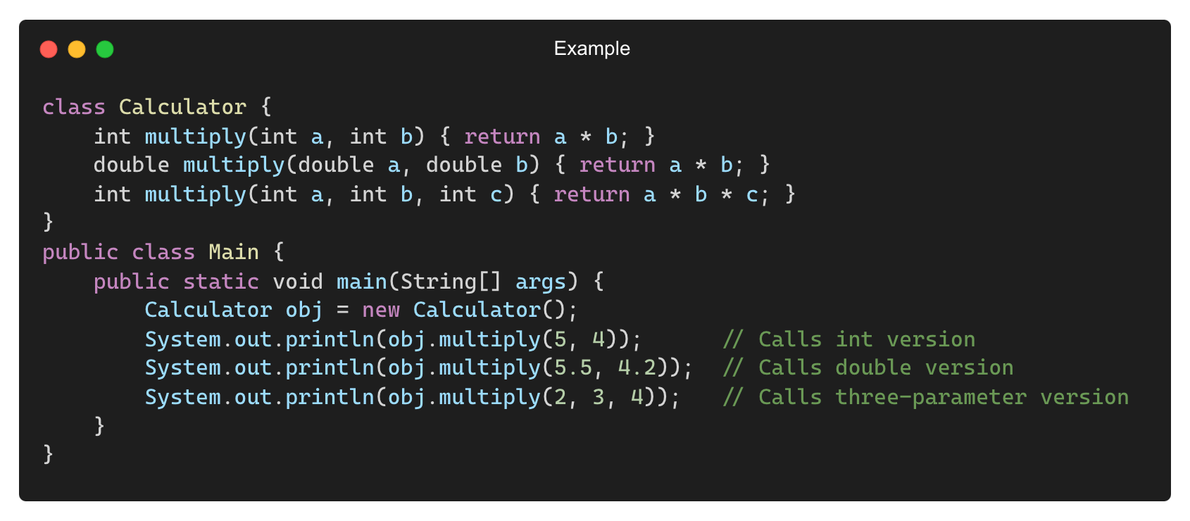
Method Overloading
Overloading is achieved by:
Changing the number of parameters
Changing the type of parameters
Output:
20
23.1
24

Slide 6
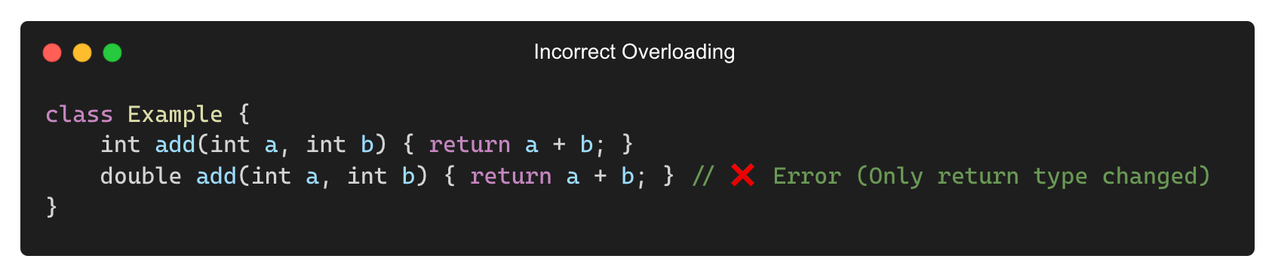
Rules for Method Overloading
✅ Methods must have the same name
✅ Different parameter lists (number or type)
✅ Return type does not play a role
❌ Cannot overload by just changing return type

Slide 7
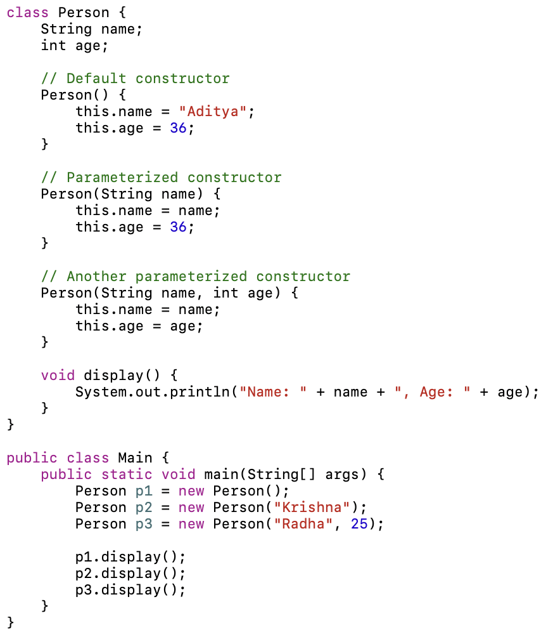
Constructor Overloading
Multiple constructors with different parameter lists.
Output:
Name: Aditya, Age: 36
Name: Krishna, Age: 36
Name: Radha, Age: 25

Slide 8
Method Overloading vs Overriding
Feature | Method Overloading | Method Overriding
Definition | Multiple methods with the same name but different parameters | Subclass method redefines a method from the parent class
Parameters | Must be different | Must be the same
Return Type | Can be the same or different | Must be the same
Inheritance | Not required | Requires inheritance
Access Modifier | Can be changed | Cannot be weaker than the original method

Slide 9
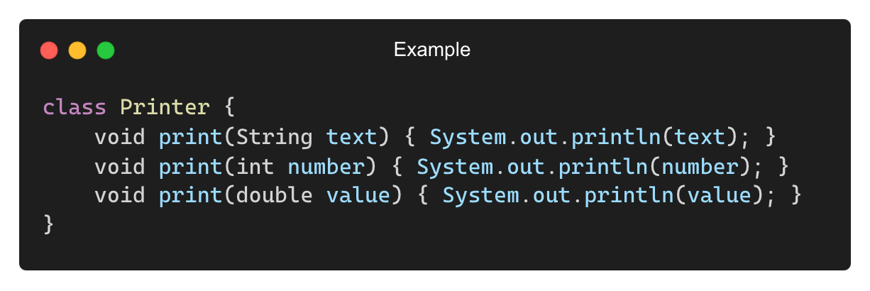
When to Use Method and Constructor Overloading?
When methods need to perform similar operations on different types of data
When constructors need multiple ways to initialize an object
To improve code readability and reusability

Slide 10
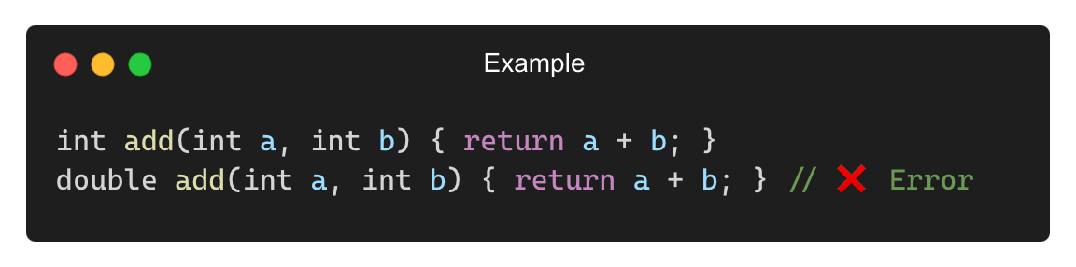
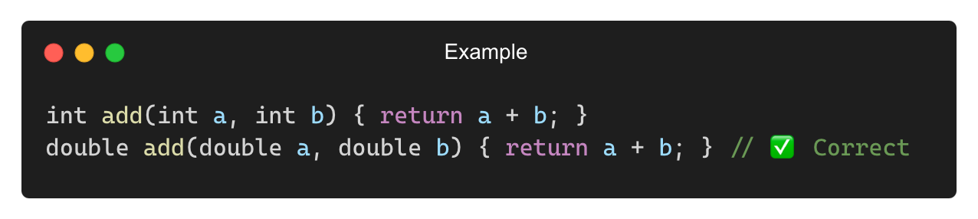
Common Mistakes with Overloading
❌ Changing Only the Return Type (Not Allowed)
✅ Solution:

Slide 11
“static” keyword in JAVA

Slide 12
What Does static Mean in Java?
• The static keyword associates a variable or method with the class rather than with objects.
• A static member belongs to the class and is shared among all instances.
• Static members do not require object creation to be accessed.

Slide 13
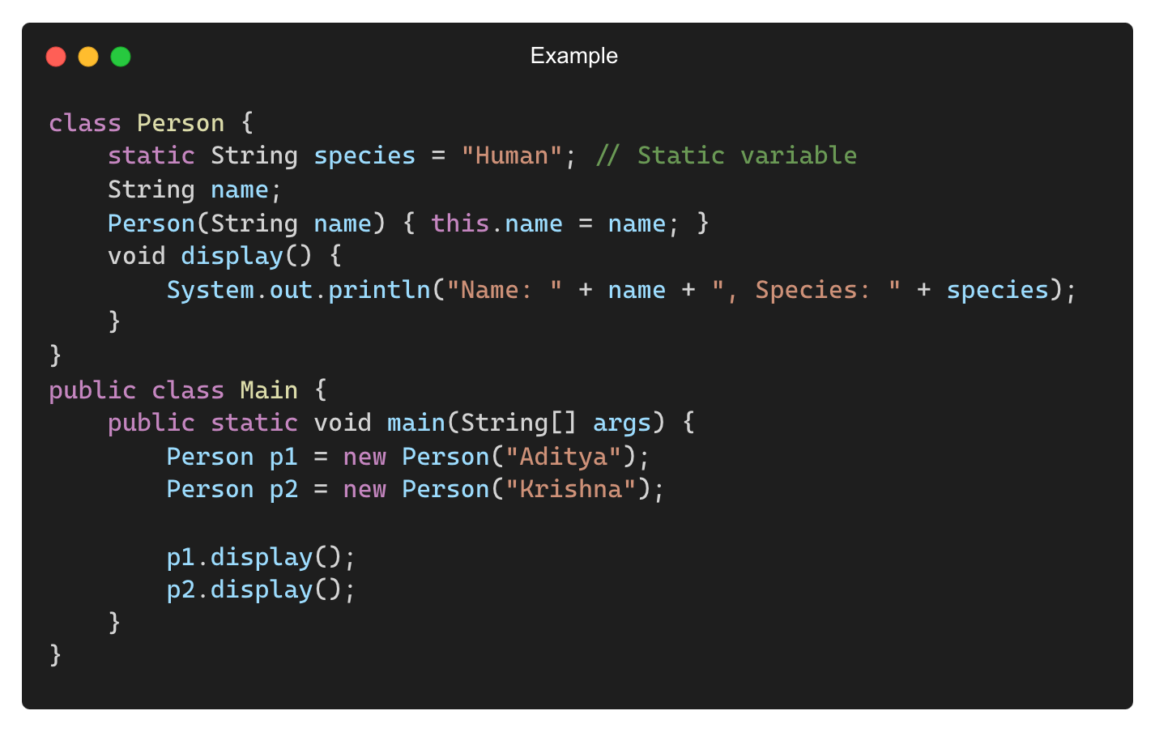
Static Variables (Class Variables)
Static variables are shared among all objects of a class.
Output:
Name: Aditya, Species: Human
Name: Krishna, Species: Human

Slide 14
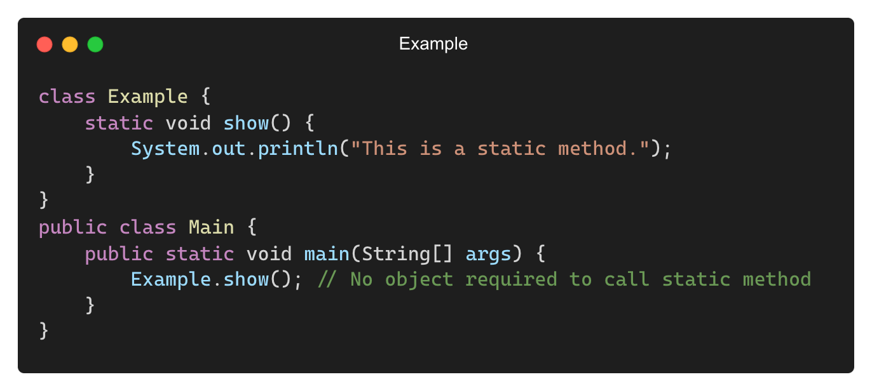
Static Methods in Java
Static methods belong to the class and cannot access instance variables directly.
Output:
This is a static method.

Slide 15
Differences Between Static and Instance Members
Feature | Static Members | Instance Members
Belongs To | Class | Object
Accessed Using | Class Name or Object | Only through Object
Requires Object Creation? | No | Yes
Can Use “this”? | No | Yes
Memory Allocation | Single copy shared | Separate copies for each object.

Slide 16
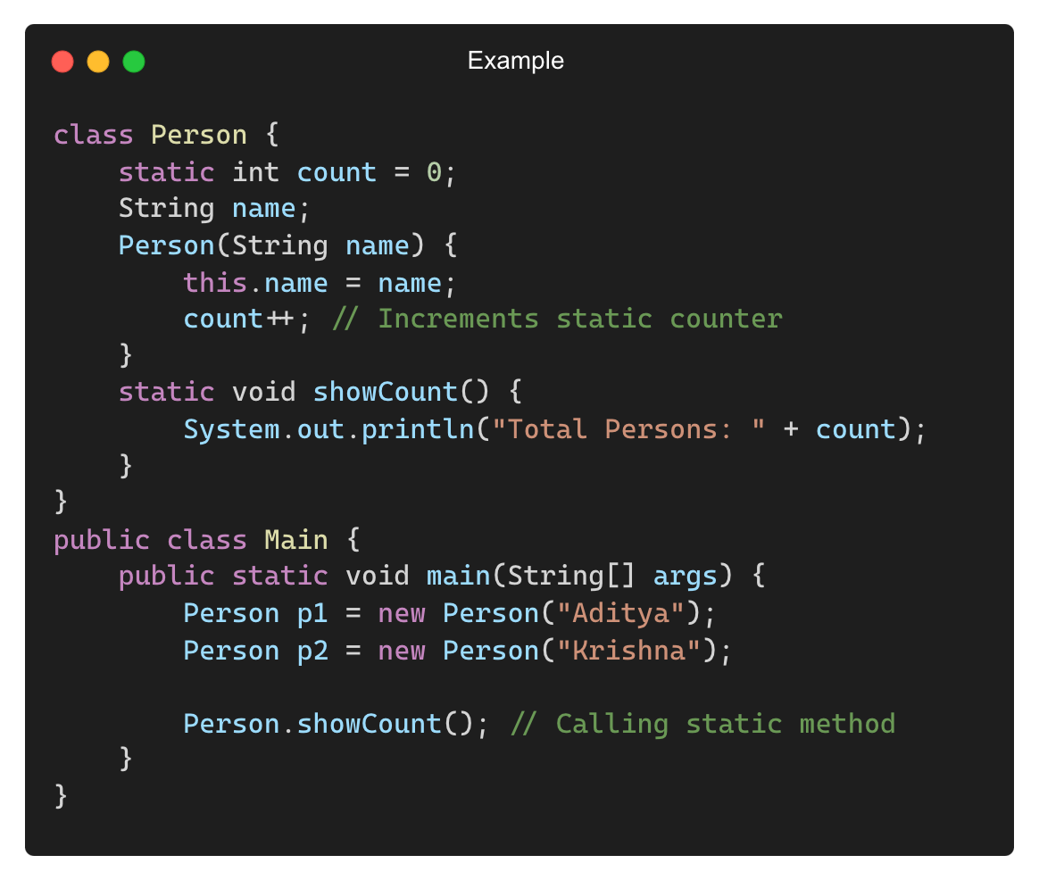
When to Use Static Members?
When a value is common for all objects (e.g., PI in Math.PI).
Utility methods that don’t require object data (e.g., Math.sqrt()).
To keep memory usage low by avoiding duplication in objects.
Example: Keeping a Static Counter of Objects

Slide 17
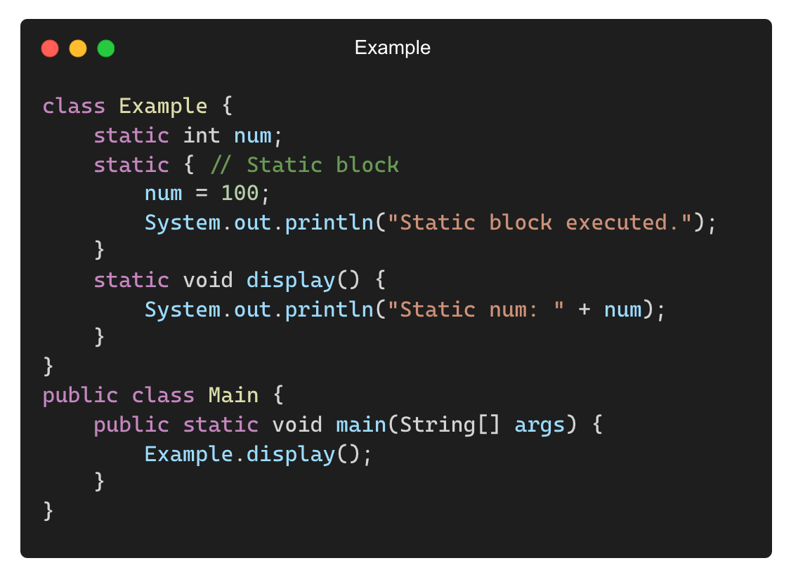
Static Blocks in Java
Static blocks execute when the class is loaded.
Used for static variable initialization.
Output:
Static block executed.
Static num: 100

Slide 18
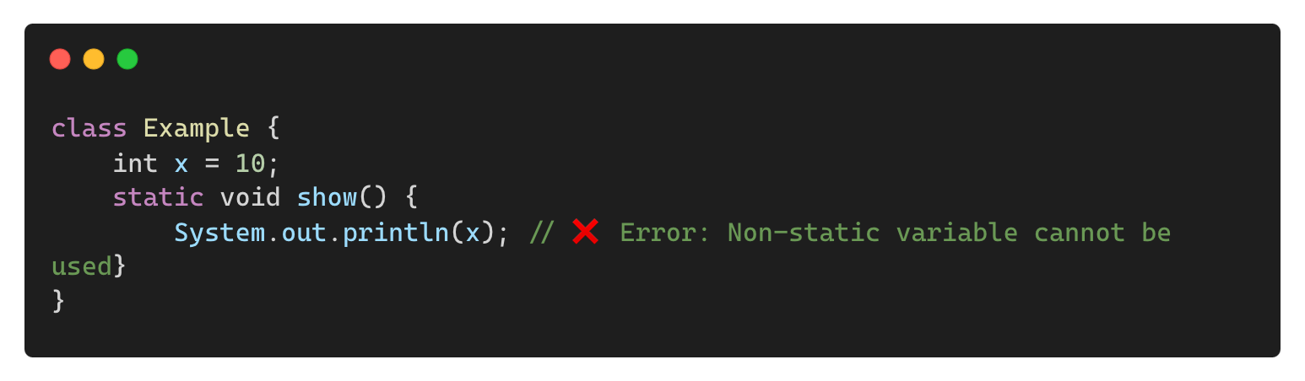
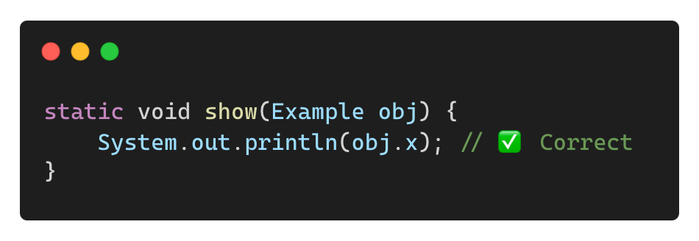
Common Mistakes with Static Members
❌ Trying to Access Non-Static Variables in a Static Method
✅ Solution: Use an object to access instance variables inside a static method.

Slide 19
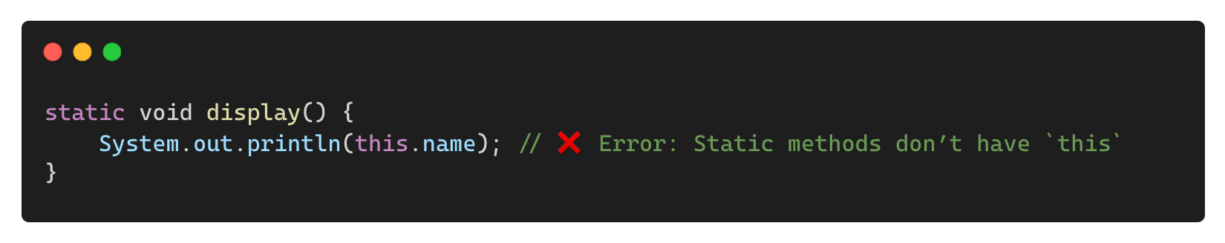
Common Mistakes with Static Members (Contd.)
❌ Using this Inside Static Methods
✅ Solution: Use instance variables only in non-static methods.

Slide 20
THANK YOU

